Slide 1


Slide 2
10
convolution

Slide 3
9
Central Limit Theorem
X = X₁ + … + X_{n} independent with same PMF/PDF
lim P(X ≤ E[X] + t√Var[X] ) = P(Normal(0, 1) ≤ t)
n → ∞

Slide 4
40 Bernoulli(1/2)
20 Poisson(1)
10 Uniform(0, 1)
Normal(0, 1)

Slide 5
Sum of Independent Normals
Normal(0, 1) + … + Normal(0, 1)
= Normal(0, √n)
Normal(μ, σ) + Normal(μ’, σ’)
= Normal(μ + μ’, √σ² + σ’²)
if independent

Slide 6
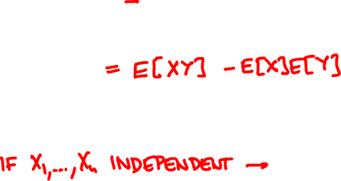

8
Variance and covariance
Var[X] = E(X – E[X])² = E[X²] – E[X]²
Cov[X, Y] = E[(X – E[X])(Y – E[Y])]
Var[Σ X_{i}] = Σ Var[X_{i}] + Σ Cov[X_{i}, X_{j}]

Slide 7
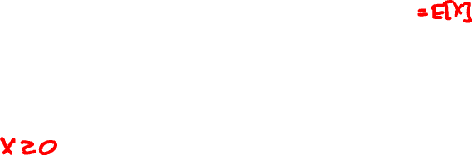
7
large deviations
μ
a
Markov’s inequality:
p.m.f. / p.d.f. of X
P( X ≥ a ) ≤ μ / a.
0
μ – tσ
μ
μ + tσ
Chebyshev’s inequality:
P(|X – μ| ≥ tσ ) ≤ 1 / t².
σ
p.m.f. / p.d.f. of X

Slide 8
The weak law of large numbers
X₁,…, X_{n} are independent with same PMF/PDF
μ = E[X_{i}], σ = √Var[X_{i}],
X = X₁ + … + X_{n}
For every ε, δ > 0 and n ≥ σ²/(ε²δ):
P(|X/n – μ| ≥ ε) ≤ δ

Slide 9
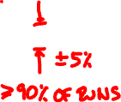
X₁ + … + X_{n}
n
n

Slide 10
The strong law of large numbers
X₁,…, X_{n} are independent with same PMF / PDF
μ = E[X_{i}], X = X₁ + … + X_{n}
If E[X_{i}⁴] is finite then
P(lim_{n → ∞} X/n = μ) = 1

Slide 11
The strong law of large numbers

Slide 12
6
axioms of probability
1. for every E: 0 ≤ P(E) ≤ 1
S
E
2. P(Ω) = 1
S
3. If E₁, E₂,… disjoint then
S
E₁
E₂
P(E₁∪E₂∪…) = P(E₁) + P(E₂) + …

Slide 13
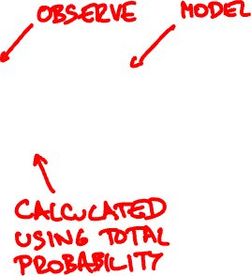
5
Bayes’s rule
f_{X|Y}(x | y) f_{Y}(y)
f_{Y | X}(y | x) =
f_{X}(x)

Slide 14

4
total probability / expectation
f_{X}(x) = ∑_{y} f_{X|Y}(x | y) f_{Y}(y)
f_{X}(x) = ∫ f_{X|Y}(x | y) f_{Y}(y) dy
E[X] = ∑_{y} E[X | Y = y] f_{Y}(y)
E[X] = ∫ E[X | Y = y] f_{Y}(y) dy

Slide 15
3
linearity of expectation
E[X + Y] = E[X] + E[Y]

Slide 16
2
independence
P(A∩B) = P(A) P(B)
or P(B | A) = P(B)

Slide 17
Independence of multiple events
P(A∩B) = P(A) P(B)
P(B∩C) = P(B) P(C)
P(A∩C) = P(A) P(C)
and
P(A∩B∩C) = P(A) P(B) P(C).

Slide 18
Conditional independence
P(A ∩ B | F) = P(A | F) P(B | F)
or P(A | B ∩ F) = P(A | F)

Slide 19
1
know what you are doing!
1. Specify all possible outcomes
2. Identify event(s) of interest
3. Assign probabilities
4. Shut up and calculate!

